Slide 1


Social Media Analytics Tracker
This presentation outlines the development of a powerful tool for analyzing social media performance metrics.
Presented by
Muhammad abdullah khan
Minhal faheem
Slide 9

Slide 2

Project Overview
Purpose
Target Audience
Track social media post performance to provide valuable insights into engagement levels and optimize posting times.
Social media managers, content creators, and individuals managing social accounts.
Slide 9

Slide 3
Core Features
1
Adding Posts
2
Displaying Posts
3
Analytics Summary
Users can input details for each post: title, likes, comments, and shares.
View a comprehensive list of all stored posts, including their respective metrics.
Access a consolidated view of total likes, comments, and shares across all posts.
4
Top-Performing Post
5
Posting Time Suggestions
Identify the post with the highest engagement based on the calculated score.
Gain insights into optimal posting times based on overall engagement levels.
Slide 9

Slide 4
Technical Implementation
Programming Language
Data Structure
C++ is chosen for its efficiency and flexibility in handling data structures.
A struct called 'Post' stores title, likes, comments, and shares. An array of 'Post' is used to store up to 100 posts.
Slide 9

Slide 5
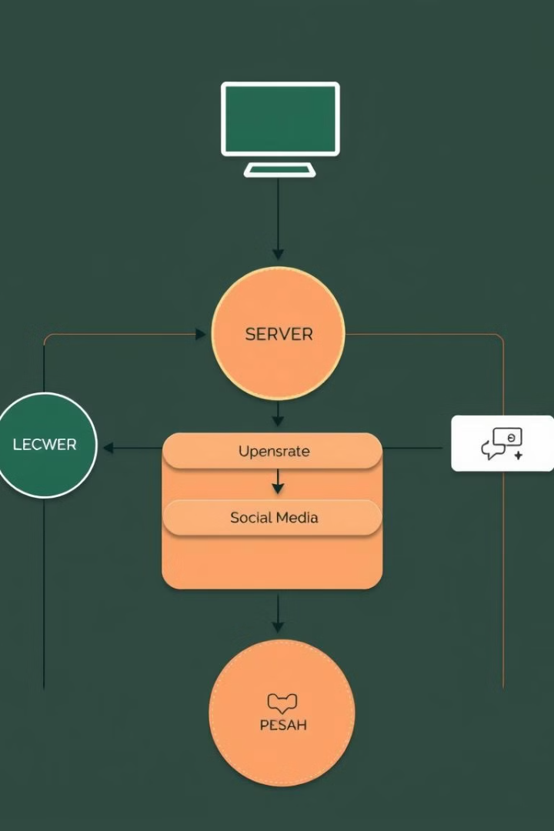



Code Flow
Main Menu
The user is presented with a menu offering options such as adding posts, viewing posts, analytics, top post, posting time suggestions, and exiting.
User Interaction
Simple and intuitive input prompts guide the user through each operation.
Data Validation
The code prevents adding more than 100 posts and handles invalid menu choices gracefully.
Slide 9

Slide 6

Advantages
Simplicity
Scalability
The tracker is designed for easy use by individuals with varying technical expertise.
The modular code structure allows for future expansion with added features and integrations.
Insights
Provides valuable data for optimizing content strategy and improving social media engagement.
Slide 9

Slide 7




Limitations
Static Storage
Manual Input
Basic Engagement Calculation
Limited to storing a maximum of 100 posts, requiring future enhancements for scalability.
Requires manual input of metrics, which could be automated with platform integrations.
Uses a simple sum of metrics without incorporating advanced weighting or trend analysis.
Slide 9

Slide 8




Future Enhancements
1
Dynamic Storage
2
API Integration
3
Advanced Analytics
4
User-Friendly Interface
Slide 9

Slide 9

Conclusion
The Social Media Analysis Tracker provides a solid foundation for users to analyze their social media performance effectively. With continued development, this tool can become a powerful analytics platform with a wide range of capabilities.
Slide 9

